Slide 1
mentorwise
Mentorship application that links those who want to be a mentor or would like to shadow a professional of a specific field or industry

Slide 2

Contents
Frameworks and use
Technologies/Tools
Lifecycle model
Testing/Hurdles
Future Implementations

Slide 3
Frameworks and use
Become a mentor or sign up as a mentee.
Input current experiences, interests, and goals.
Be placed into a directory database.
Matches mentees & mentors based on industry or field.

Slide 4
Technologies/Tools
HTML/HandleBars
CSS/Bootstrap
Javascript
JQuery
MySQL
Node
Express
GET/POST
APIs
Routes
Google Fonts
GIT

Slide 5
Lifecycle model

Slide 6

Testing/Hurdles
Git/Merge issues
Posting

Slide 7
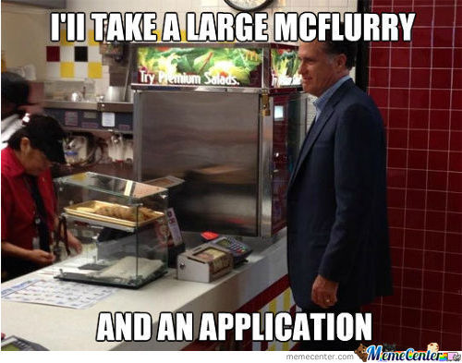
Future implementations
Enable individual accounts and use of login.
Allow user ratings of mentors and/or industries and fields.
Greater location services/radius input.
Allow job postings or internship postings.

Slide 8
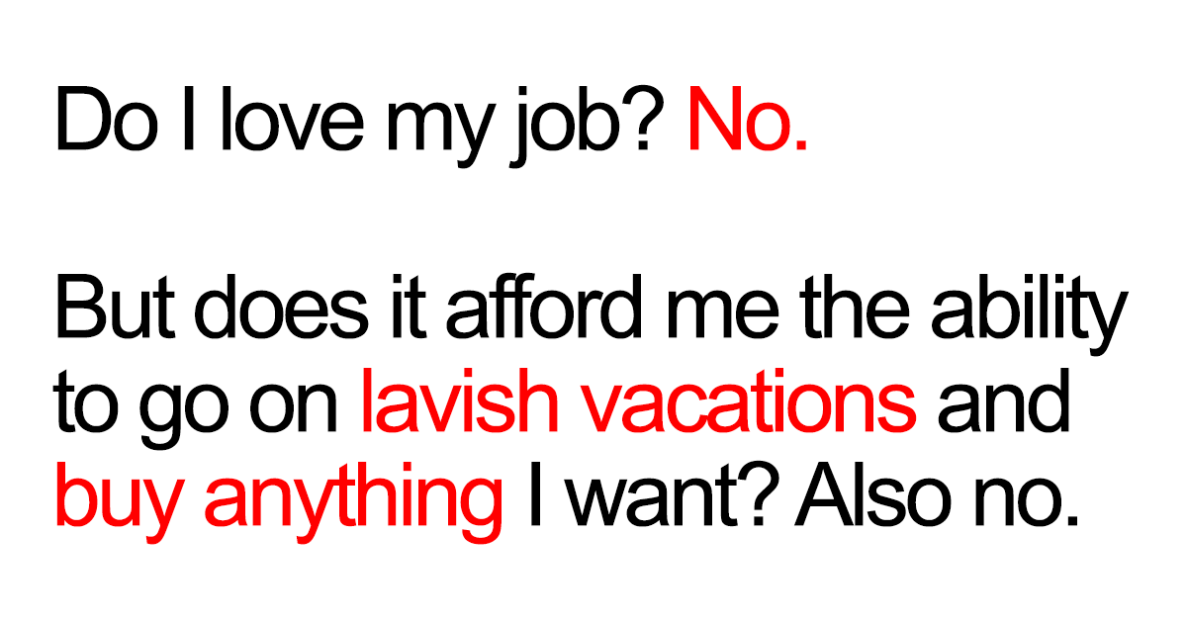
fIN
Questions?
Comments? (If you dare…)

